Slide 1
Assessments, weightage, deadlines
Assessment | Weightage | Deadline
Pre-Course Quiz 1 | 2% | 18 Aug 2023, 1200 noon
Pre-Class Quiz 1 | 2% | 11 Sep 2023, 1200 noon
Tutor Marked Assignment | 18% | 15 Sep 2023, 2355 hrs
Pre-Class Quiz 2 | 2% | 09 Oct 2023, noon
Group Based Assessment | 20% | 13 Oct 2023, 2355 hrs
End-of-Course Assessment | 50% | 3 Nov 2023, 1200 noon
Participation | 6% (30% from class, 70% from forum)
Deadline
Please always refer to L-Group Announcements for any updates/changes.

Slide 2
ANL 252 Groups

Slide 3
Introductions
Name
Profession/ What you do/ What you like
Do you currently use python?
What would be one thing you want to take away from this class?

Slide 4

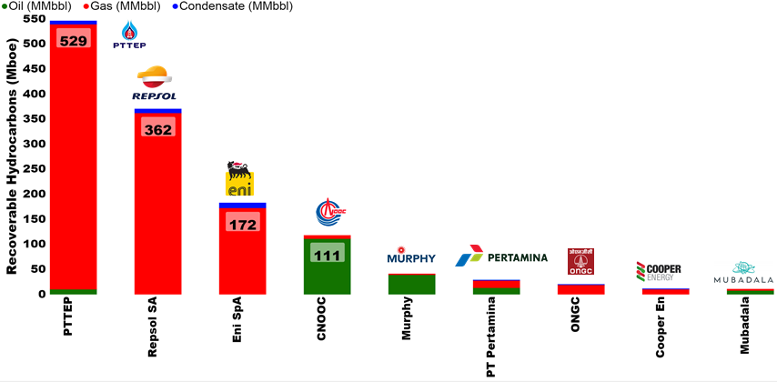
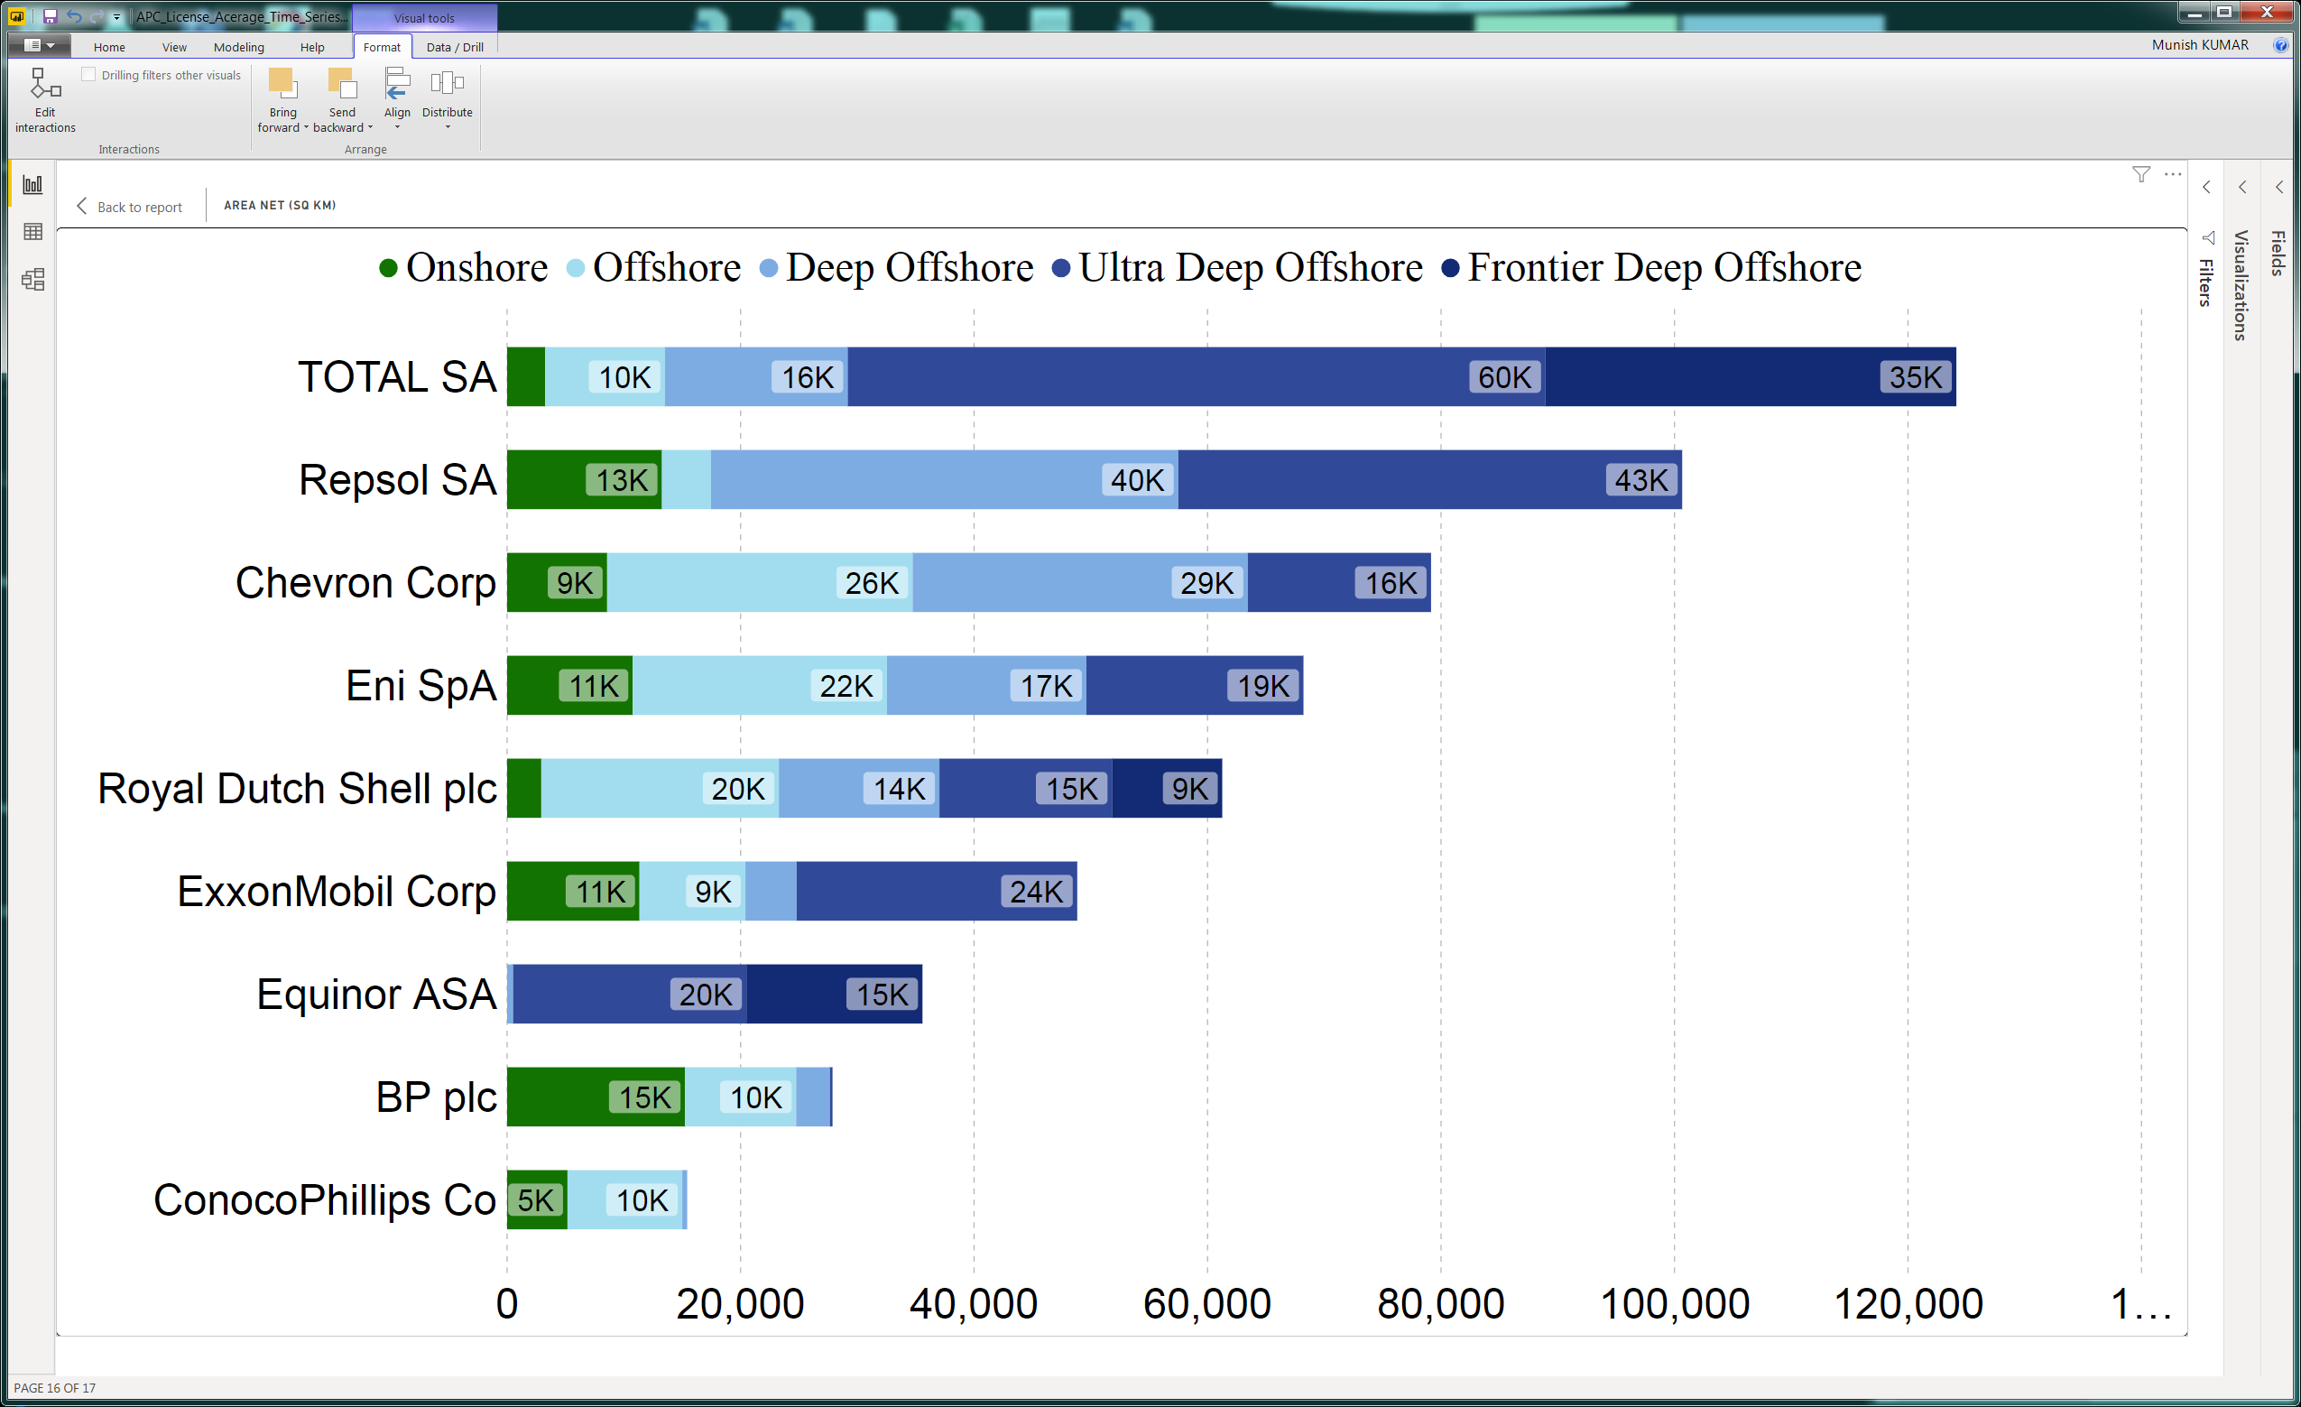
SUSS Associate faculty: Dr Munish Kumar
Email: munishkumar001@suss.edu.sg
Academic Qualification:
Ph.D. Physics, Australian National University
Courses taught at SUSS:
ANL201 Data Visualisation for Business
ANL488 Business Analytics Applied Project
ANL252 Python for Data Analytics
Active Area of Work/ Projects:
Energy Consulting, Application of Data and Visualisation in Oil and Gas, Energy, Renewables Sector
Tools of the trade: Power BI & Python, Tableau.
.

Slide 5
Learning Objectives of ANL201
By the end of this Session
Execute Python from the PowerShell command line and run Python scripts written in Atom text editor
Solve problems using Python scripts with appropriate variable names, types and operations
Print output using formatted strings, format() method and escape sequences
Create user input and use it to implement appropriate operations
Compose appropriate Boolean expressions for given data scenarios
Use while-loop and for-loop correctly, and execute breaks when desired

Slide 6
Study Unit 1 Introduction to Python Programming

Slide 7
Python Programming Environment

Slide 8
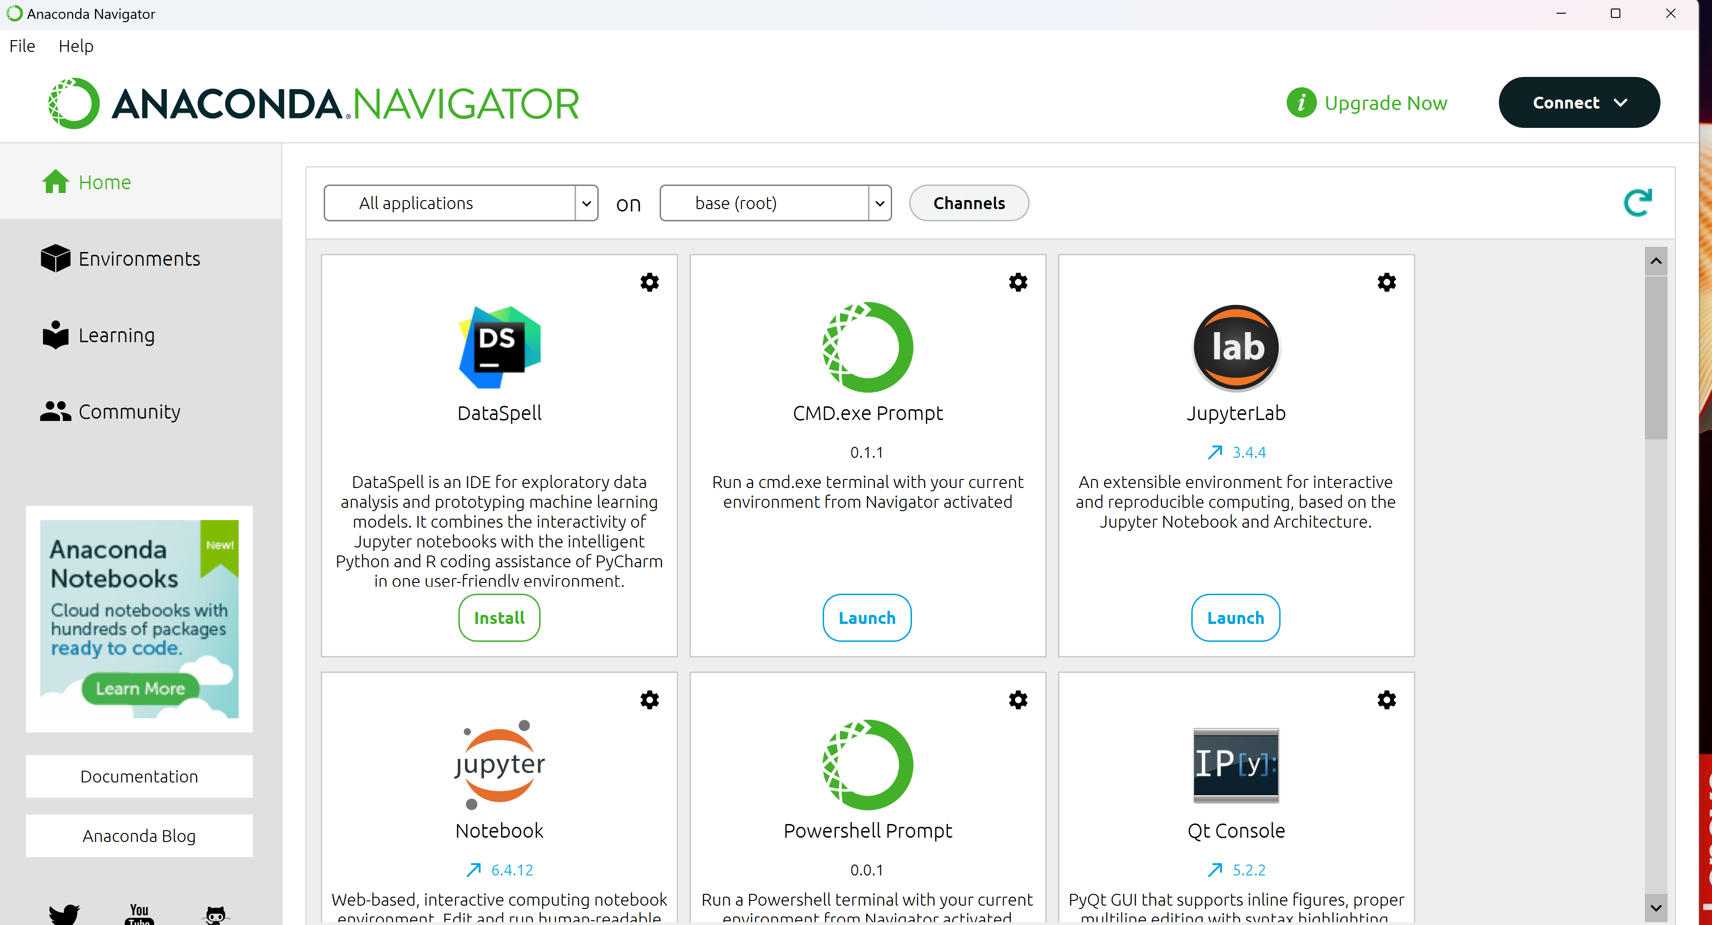
Installation of Python
Install Anaconda distribution at https://www.anaconda.com/
This installation comes with JupyterLab, Jupyter Notebook, Spyder, R Studio etc.)
Use default options for installation
After installation, choose Jupyter Notebook or JupyterLab(anaconda3) in Anaconda Navigator or from your Windows Start
Notes:
To download and install Python, you can visit the official website of Python and click on “Download Python”.
After downloading the installer, double-click on it, and the installation window will then appear.
Note that when installing it on Windows, ensure that the box “Add Python to PATH” is checked.

Slide 9
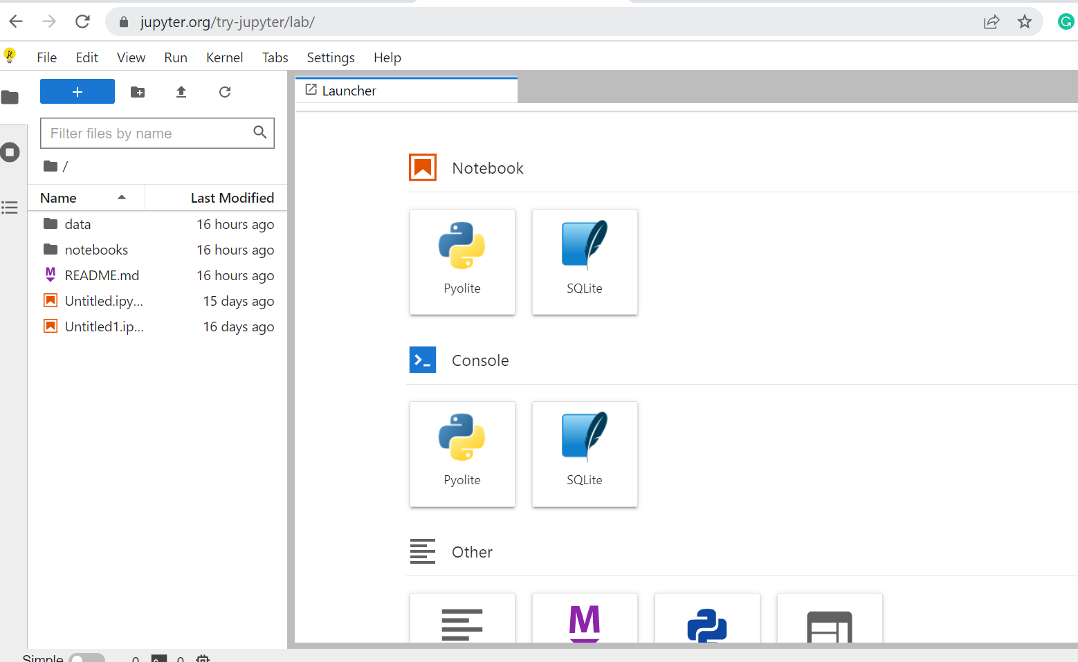
Installation of Python
Note: Students who encounter installation issues may start by using Jupyter Lab at: https://jupyter.org/try-jupyter/lab/
Notes:
To download and install Python, you can visit the official website of Python and click on “Download Python”.
After downloading the installer, double-click on it, and the installation window will then appear.
Note that when installing it on Windows, ensure that the box “Add Python to PATH” is checked.

Slide 10
Introduction to JupyterLab/Jupyter Notebook

Slide 11
Introduction to JupyterLab/Jupyter Notebook
JupyterLab/Jupyter Notebook is a web application specialised in data analytics using Python.
JupyterLab/Jupyter Notebook can be used to create Python code for
cleaning and transforming data
running numerical simulation
performing statistical modelling
data visualisation
machine learning
Notes:
Here, we will focus on Python programming for data analytics. For this purpose, we will work with another Python programming environment called the JupyterLab.
While Atom is more a Python code editor in the traditional sense, JupyterLab is an open-source web application specialised in data analytics using Python.
It is the newest Python programming interface developed by Project Jupyter.
We can use it to create code for cleaning and transforming data, running numerical simulation, performing statistical modelling, data visualisation and machine learning.

Slide 12
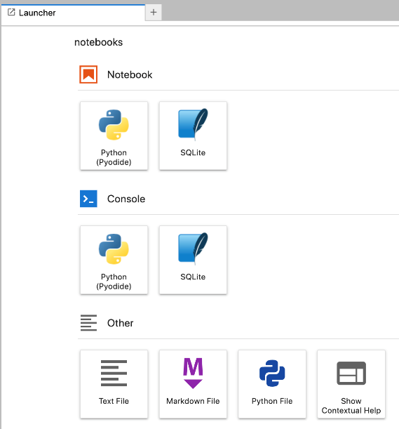
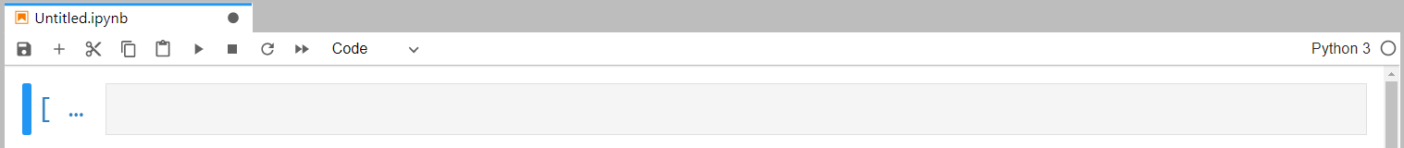
Start JupyterLab/Jupyter Notebook
Launch JupyterLab/Jupyter Notebook in your internet browser:
Notes:
Before we can start working with JupyterLab, we need to install it on our computer so that it can be integrated in the Python environment.
The pip install command refers to the same Python installer program introduced for package installation. Instead of a package, JupyterLab is the object to be installed here.
The installation could take quite a while since there are many packages that JupyterLab requires for its functionalities, and they will therefore be installed together.
The message “Successfully installed …” will appear on the terminal apps once the installation of JupyterLab has completed.

Slide 13
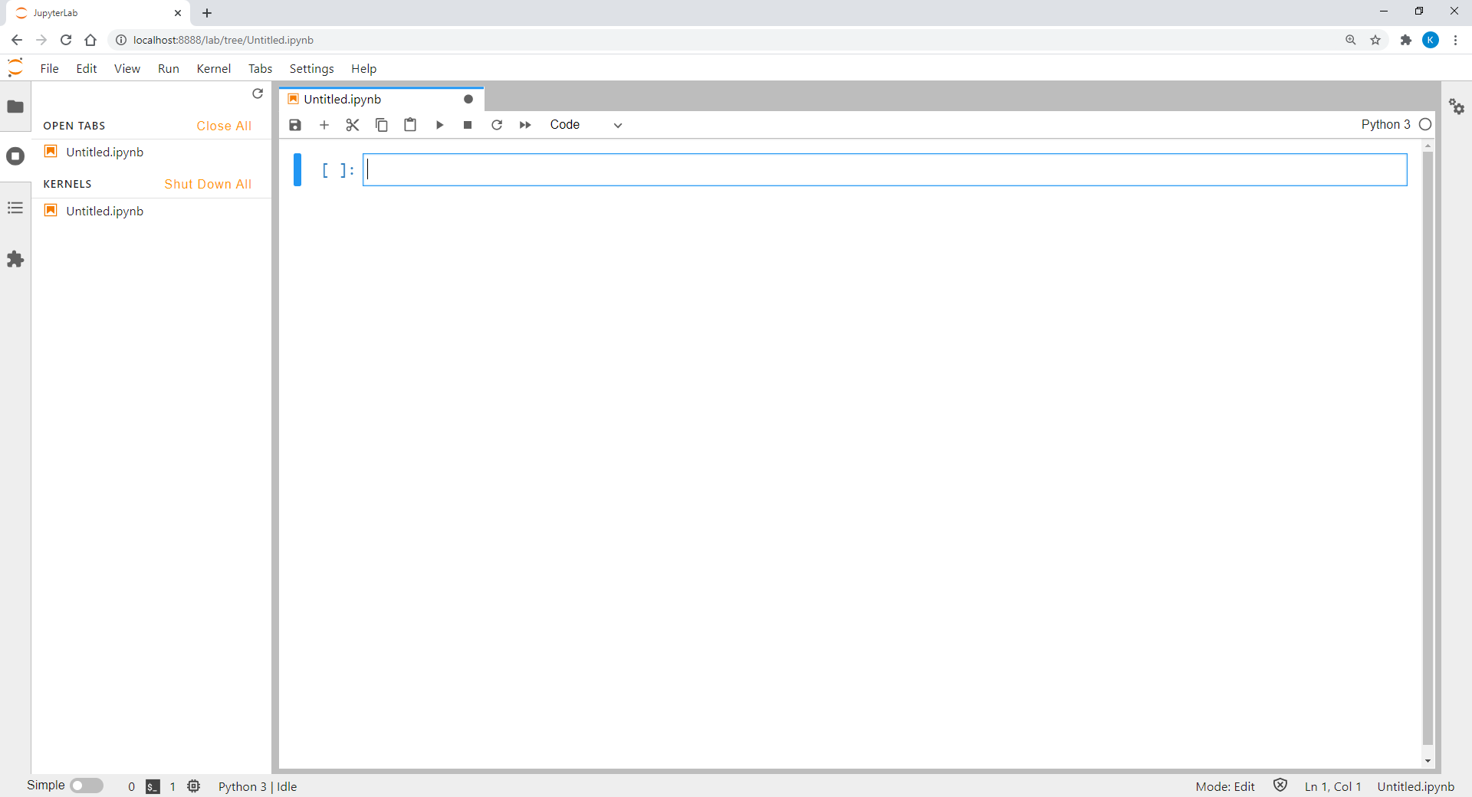
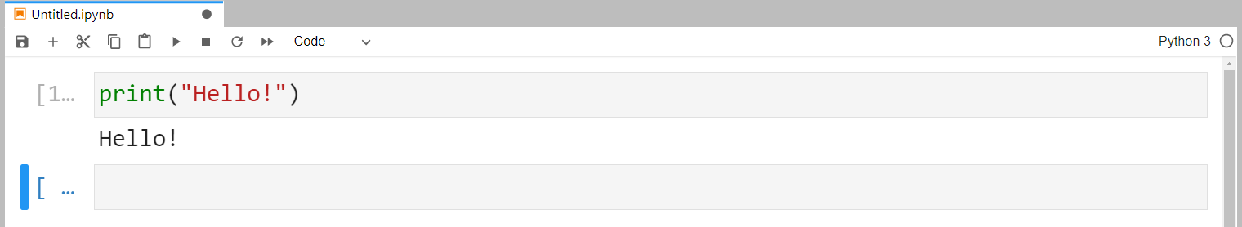
Programming with JupyterLab/Jupyter Notebook
Python program in JupyterLab/Jupyter Notebook cell can be executed by clicking or pressing CTRL + ENTER.
The output of the program script will then be printed below the input box.
Notes:
Each Python program written in a JupyterLab cell can be executed by clicking “RUN” or pressing the key combination CTRL + ENTER. The output of the program script will then be printed below the input box.

Slide 14
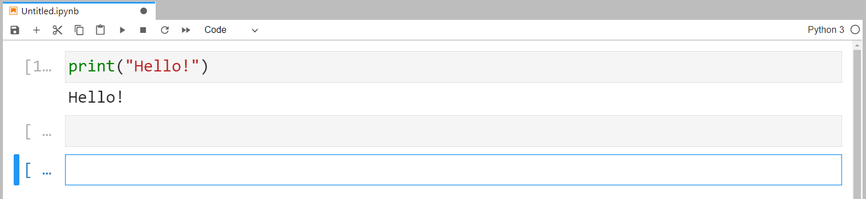
Writing and Running Codes in Cells
To add a new cell, press .
We can go back to previous cells any time and modify the code there.
Normally, JupyterLab/Jupyter Notebook only executes code of one cell.
We can run the code flexibly regardless the sequence of the cells.
To run all cells, go to “Kernel” and select “Restart Kernel & Run All Cells…”.
In this case, the order of the cells becomes essential.
Notes:
After running the first script, JupyterLab will usually add a new cell for us to start another task. Nevertheless, we can also add it manually by pressing “ADD”.
Once a new cell has been inserted, we can write another set of script in it. We can also choose to go back to the previous cell and modify the code written there.
Note that in JupyterLab, Python only executes the code written in one cell. In other words, we can return to the “upper” cells and re-run the code there when it is necessary.
If we want to execute the programs in all cells, we can go to the “Kernel” menu and select “Restart Kernel & Run All Cells…”.
In this case, we have to pay attention to the sequence of the cells since the logical flow among them will become relevant.

Slide 15
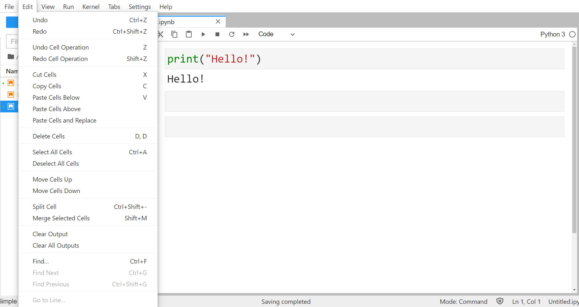
Edit JupyterLab Notebook
JupyterLab provides many functions to restructure our Python scripts.
Below is the “Edit” menu with all available options.
Notes:
In the “Edit” menu, there are many functions that JupyterLab provides us to restructure our Python scripts.
For example, we can switch the order of the cells by moving them up and down. We can also cut, copy, paste, and delete them. JupyterLab enables us to merge multiple cells into one or split a single cell into two or more cells as well.

Slide 16
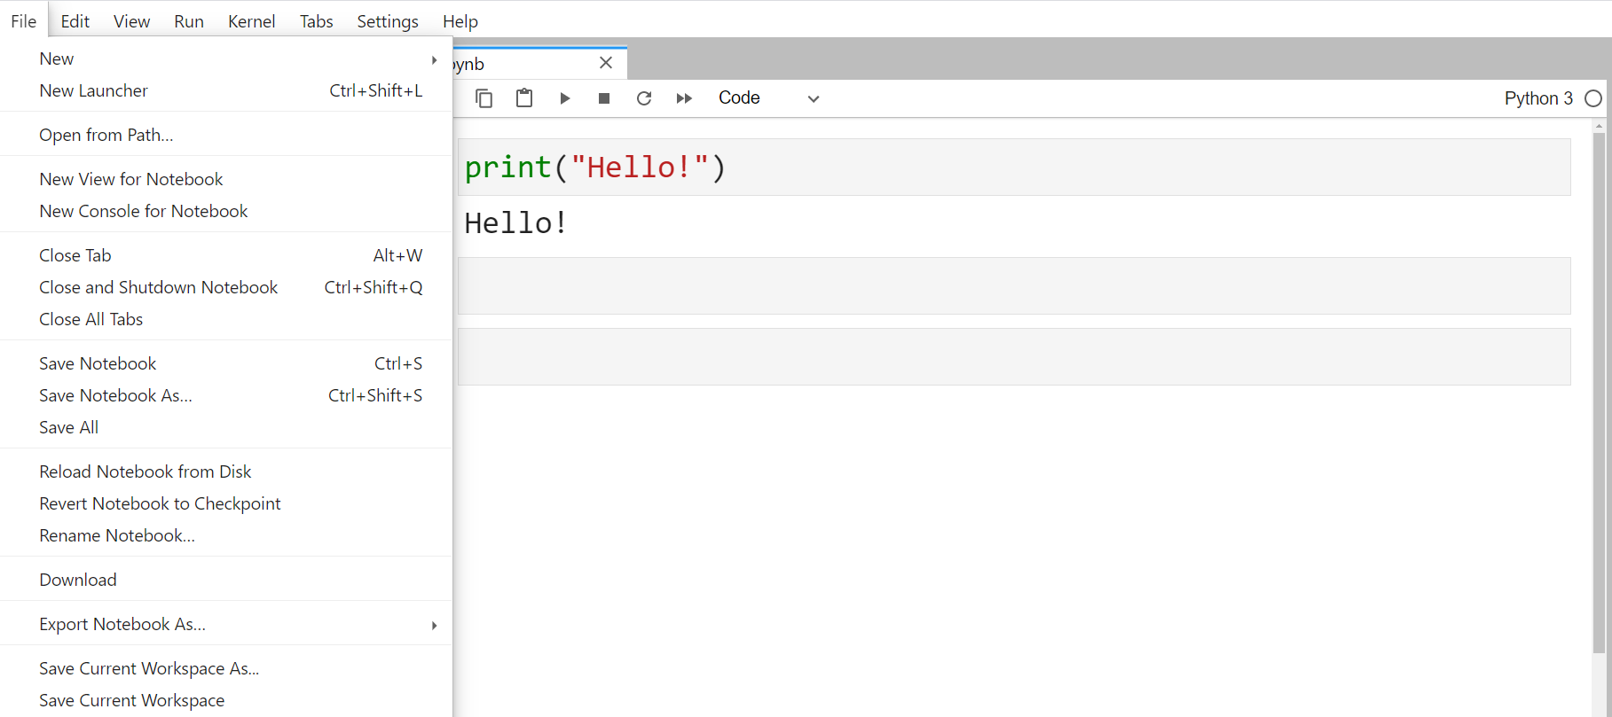
Save JupyterLab Notebook
Save JupyterLab notebook by pressing or “Save Notebook as…” in the “File” menu.
Notebook is saved as a “.ipynb” file in the folder where JupyterLab was started.
Notes:
To save a Python program in JupyterLab, we can either press the “SAVE” icon or choose “Save Notebook as…” in the “File” menu.
The file will then be saved with the “.ipynb” extension in the folder where JupyterLab was started in the terminal apps.

Slide 17
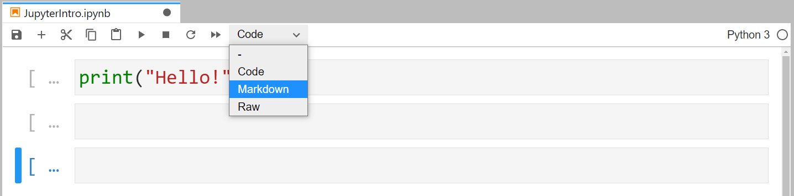
Markdown
JupyterLab can be used an advanced text editor.
Headers, elaborative texts, HTML codes, etc., all could be embedded in a JupyterLab notebook.
To create the corresponding format, switch the cell type from “Code” to “Markdown”.
Notes:
Another advantage of using JupyterLab is that we can use it as an advanced text editor.
Besides Python programs, we can also embed elaborative texts to the program or write HTML codes to design a website with it.
All we need for the start is to switch the cell type from “Code” to “Markdown”.

Slide 18
Activity
Start JupyterLab, open a new notebook and carry out the following tasks:
Carry out simple calculations such as 2 * (3 – 1.5²).
Print the result of the calculation using formatted printing in another cell.
Insert a markdown cell before the cell of step 1 and describe the calculation to be carried out.
Re-run all cells.
Save the notebook on the computer.

Slide 19
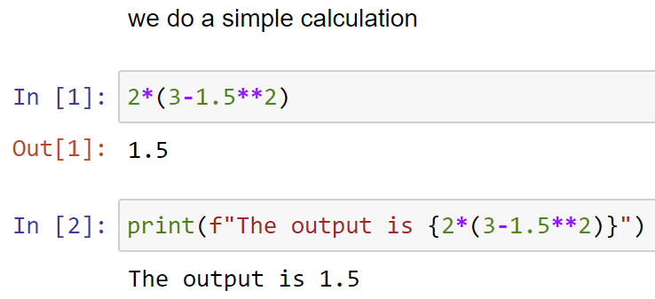
Activity (answers)

Slide 20
Basic Arithmetic and Variables

Slide 21
Arithmetic Operators
Python can carry out very sophisticated tasks.
But we can also use it as a simple calculator.
Operator | Function
+ Addition | Adds values on either side of the operator.
- Subtraction | Subtracts right hand operand from left hand operand.
* Multiplication | Multiplies values on either side of the operator.
/ Division | Divides left hand operand by right hand operand.
% Modulus | Returns remainder of a division.
** Exponent | Performs exponential (power) calculation on operators.
// Floor Division | Returns remainder after removing the decimal point.
Notes:
Before we start writing more sophisticated programs, we shall first go one step backwards and familiarise ourselves with the most origin function of a computer: calculation.
Python can be powerful in many ways, but we can also use it for very trivial tasks such as adding two numbers together.
For example, we can instruct Python to carry out a simple addition such as 2 + 7 for us. Similarly, we can also command Python to do other basic arithmetic operations.
Here are some available arithmetic operators for mathematical calculations in Python.

Slide 22
Mathematical Calculations
Same as usual mathematics, calculation priority:
Parentheses > exponentiation > multiplication/division > addition/subtraction
Not included in basic Python: square root, logarithm, exponential, trigonometrical functions, etc.
Need import of the “math” library in the program.
Notes:
Same as normal mathematics, the exponent operator has higher priority in any calculation than the operators of multiplication or division, which in turn will be calculated prior to the addition or subtraction operators.
Furthermore, we can add parentheses to our equation to indicate that those terms within a parenthesis should have the highest priority in the calculation.
Note that mathematical functions such as the square root, the logarithm, the exponential, or the trigonometrical functions are not included in basic Python.
If we want to include these functions in our calculation, we will need to import the “math” library in our code.

Slide 23
Variables
Automate routine operations without program adjustment.
Flexibility for programmers and users.
Keep program general.
Notes:
In most of the situations, we wish to write programs that help us automate routine operations without adjusting our programs according to the actual needs.
For instance, we may not always want to add 2 and 7 together. Instead, we would prefer to let the computer add up any pair of arbitrary numbers for us, and we can choose these numbers depending on the situation.
As a result, we would like to keep our program as general as possible by using variables instead.

Slide 24
Variable Names
Variable names can be any arbitrary combination of
characters (A-Z, a-z),
underscores (_), and
numbers (0-9).
Variable names can be short as a single character or more descriptive.
Must start with a letter or the underscore character.
Cannot start with a number.
Case-sensitivity (age, Age and AGE are different!).
Notes:
In python, we define a variable by its name which is an arbitrary combination of characters (A-Z, a-z), underscores (_) and numbers (0-9).
Subsequently, we assign a value to the variable and let Python operate with it.
And we can change the value of the defined variable at any stage of our program.
In Python, a variable can have a short name (e.g. x, y, z) or a more descriptive name (e.g. age, carname, total_volume). And there are certain rules that we must follow when we create our variable names.
A variable name must start with a letter or an underscore.
A variable name cannot start with a number.
A variable name can only contain alpha-numeric characters and underscores (A-z, 0-9, and _).
Variable names are case-sensitive (age, Age and AGE are three different variables).

Slide 25
Assign Values to Variables
Value is changeable at any stage of the program.
Assign value by the syntax
Important: Place variable left of the equal sign and the value right of it!
variable = value
Notes:
To assign a value to a variable, all we need to do is the syntax in the blue box.
Remember that it is important to put the variable left of the equal sign (=) and the value right of it.
If we switched their positions, it would be equivalent to assigning a name to a number. This would result in a syntax error, and Python will stop executing the rest of the program at once.
Once values are assigned to variables, we can use them for any arithmetic operations.

Slide 26
Variable Types (I)
Type | Description
Integer | Values without decimal point. Can be positive or negative.
Float | Arbitrary numeric value with a floating point.
String | Contains letters in both cases, special characters, and numbers. No mathematical operations can be applied on numbers assigned as string to a variable. Values must be written in a pair of quotation marks (single or double). Two strings can be concatenated by being “added up”.
Boolean (Bool) | True or False.
Notes:
In Python, there are different types of variable that we can work with.
In the previous section, we assign numeric values to variables which makes them become numeric variables.
Nevertheless, there are also different types of numeric variable, or different types of variables in general.
This table shows some main types of variable available in Python.

Slide 27
Variable Types (II)
Use type() function to check the type of the variable.
Python returns following values: int (for integer), float (for float), or str (for character string).
Expression is the general term for variables or when they are linked with operators, e.g., a + b.
Notes:
In the following, we will use the general term expression for variables or when they are linked with operators.
For instance, a + b is an expression and not a variable, unless we define c = a + b in our program where c is then a new variable.
However, we would rather refer to expressions directly in our program since we do not always define new variables for calculation steps in between.
To check the type of a variable, we can use the type() function on any variable in our program. Python will then print the variable type such as int (for integer), float (for float), or str (for character string) to the screen.

Slide 28
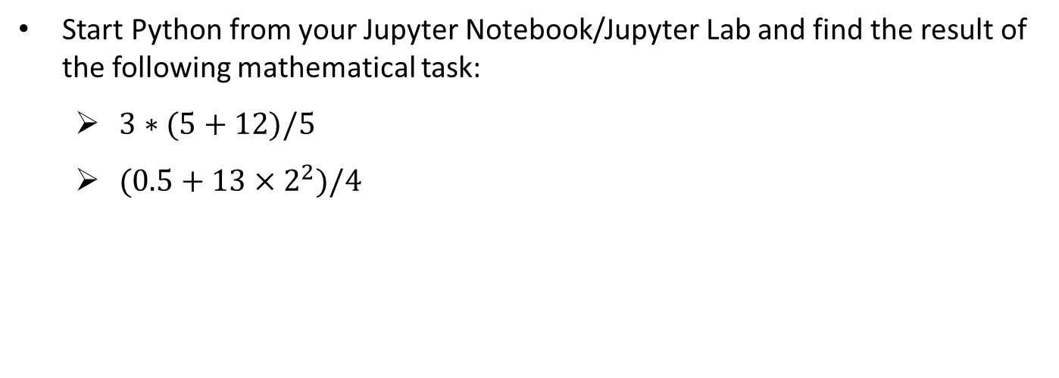
Activity
Start Python from your Jupyter Notebook/Jupyter Lab and find the result of the following mathematical task:
$3∗(5+12)/5$
$(0.5+13×2^{2})/4$

Slide 29
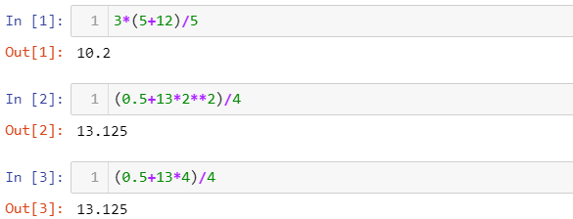
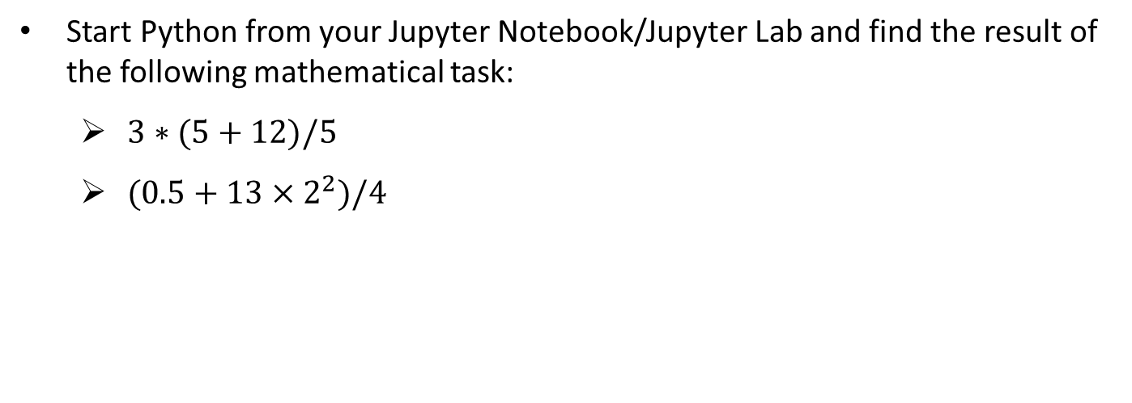
Activity (Answer)
Start Python from your Jupyter Notebook/Jupyter Lab and find the result of the following mathematical task:
$3∗(5+12)/5$
$(0.5+13×2^{2})/4$

Slide 30
Discussion
How do we carry out mathematical calculations in Python? How similar is it in comparison to formulas written on paper?
What are the rules that a Python variable name must follow?
What is the difference between an integer and a float variable?

Slide 31
Discussion (Answer)
How do we carry out mathematical calculations in Python? How similar is it in comparison to formulas written on paper?
Symbols differ (i.e., ** for exponents)
Same order of operations (i.e., paranthesis takes priority)
What are the rules that a Python variable name must follow?
Cannot start with a number
What is the difference between an integer and a float variable?
Integer without decimal point

Slide 32
15 min Break

Slide 33
Print and Input

Slide 34
Printing
One main task of a computer program is to show information to the user while it is running.
Use print() function to generate screen output.
For both pre-defined strings or expression values.
When printing strings, put the content within the quotation marks.
print("My String")
print(expression)
Notes:
Writing programs is not only to automate routine operations by the computer.
It is also of interest to show the results, information, or messages to the user while the Python program is running.
We can use the print() function to generate screen output for the user to read.
In the print function, we can use a pre-defined string or any expression as the printing content.
If it is an expression, it will be evaluated during runtime and the value in it will be printed to the screen.

Slide 35
Formatted Printing
Formatted printing combines pre-defined strings with values of expressions for screen output.
The combination of pre-defined strings with values of expressions is also called formatted string.
Add an “f” before the open quotation mark of the printing string.
Wrap the expressions within a pair of curly brackets {}.
Another option for formatted printing is the .format() method.
print(f"My String {expression1} {expression2} …")
print("My String {} {}".format(expression1, expression2))
Notes:
If we ask Python to execute the mathematical operation score1 + score2, and then print it out to the screen, it will look a bit “cold” and rather not interactive to the user.
To make such an output to look more like a statement addressing to the user, we can mix a statement with variables or expressions in our printing string to become a formatted string for printing, or formatted printing.
The print command is almost identical to the one for normal printing. The only difference here is to put an “f” before the open quotation mark.
Subsequently, we can place the variables or expressions that we would like to print anywhere within the text and wrap it within a pair of curly brackets {}.
We can also use the .format() method as another possibility for formatted printing. Note that the .format() method only takes one expression in its argument.
For the .format() method, we need to place the curly brackets at the position within the string where we would like to print our expression.

Slide 36
Escape Sequences (I)
Use escape sequences to print special characters that
are invisible such as ENTER or linebreak (\n).
cause syntax error such as single (') or double quotation marks within a string which is wrapped within the same type of quotation marks.
Suppose a string is put in a double quotation mark, to avoid the error:
Use single quotation marks within the string.
Use escape sequences \" within the string instead of switching between single and double quotation marks.
Notes:
Escape sequences are used to print special characters that are invisible such as ENTER, or characters that can cause syntax error such as single (') or double quotation marks (").

Slide 37
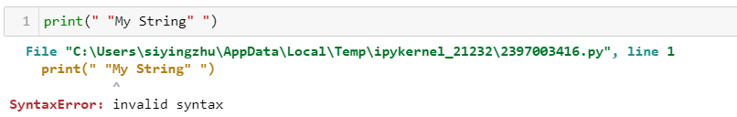
Example of escape sequences
Double quotations causes errors without using escape sequences
Double quotations does not cause errors with escape sequences

Slide 38
Escape Sequences (II)
Escape Sequences | Description
\newline | Backslash and newline ignored
\\ | Backslash (\)
\' | Single quote (')
\" | Double quote (")
\n | ENTER or line break
\b | Backspace (BS)
\t | Horizontal Tab (TAB)
\v | Vertical Tab (VT)
Notes:
Here is a list of some escape sequences in Python.

Slide 39
Input
Assign values to variables using user input during run time.
It requires users to type in something and then press ENTER.
It is allowed to use formatted strings in input().
Values assigned by an input() function are stored as string.
Convert string variables to become integer or float:
Both int() or float() only work if the input is a number.
variable = input("My String")
variable = int(input("My String"))
variable = float(input("My String"))
Notes:
While a program script is being executed, it requires values to be assigned to the variables in order to proceed in its instructions.
So far, we have discussed the possibility to assign values to the variables in the script. That means, the values are fixed when the program started to run.
However, in most of the cases, those values are unknown and can only be assigned while the program is running, mostly based on the input of the user.
In Python, we can use the input() function to ask the user to enter the value for a variable.
The whole syntax will be put on the right-hand side of an equal sign so that Python can assign the user’s input to the variable that is defined on the left-hand side of the same equal sign.
Unlike the print() function, Python requires the user to type in something and then press ENTER to complete the execution of the input() function.
Same as the print() function, we can instruct Python to print a string to the screen within the input() function. Usually, this string should be a question and/or some instructions to inform the user what they shall input here.
Furthermore, we are also allowed to mix the assigned values of some variables with the instruction text to become a formatted string that will be printed on the screen for the subsequent input.
In Python, the value assigned by the user within an input() function will be stored as string. If the input should be an integer or a number with a floating point, we can convert the input.
The functions int() and float() are used to convert a string variable to become an integer or a float variable. (Conversely, there is the str() function to convert an integer or a float variable into a string variable.)

Slide 40
Activity
Car sales program:
Create a program in which the user is asked to enter the brand, model and selling price of a car. Print the information in one print() command subsequently using formatting printing.

Slide 41
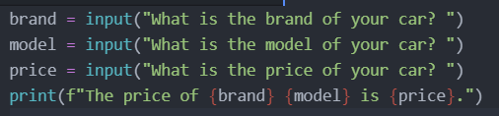
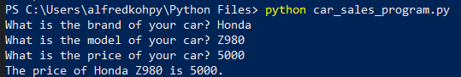
Activity (answer)
Car sales program:
Create a program in which the user is asked to enter the brand, model and selling price of a car. Print the information in one print() command subsequently using formatting printing.

Slide 42
Discussion
Why is it not possible to use double quotation marks within a string which is defined by double quotation marks as well?
What are the typical applications of escape sequences?
Notes:
Here are some reflection questions to the content of this recording:
What is the difference between formatted printing using .format() method and adding an “f” before the printing string?
Why is it not possible to use double quotation marks within a string which is defined by double quotation marks as well?
What are the typical applications of escape sequences?
Why are the values entered by the users stored as strings in Python?

Slide 43
Discussion (answer)
Why is it not possible to use double quotation marks within a string which is defined by double quotation marks as well?
End up printing the contents in the double quotation marks
What are the typical applications of escape sequences?
Introduce a new line, such as \n
Notes:
Here are some reflection questions to the content of this recording:
What is the difference between formatted printing using .format() method and adding an “f” before the printing string?
Why is it not possible to use double quotation marks within a string which is defined by double quotation marks as well?
What are the typical applications of escape sequences?
Why are the values entered by the users stored as strings in Python?

Slide 44
If-elif-else-Conditions

Slide 45
Boolean Expressions
Boolean expression has two outcomes: True or False.
Result of a single or multiple relational operations.
Multiple relational operations are combined by logical operators.
Examples of Relational Operation:
Relational Operation | Result
1 == 1 | True
3 > 2 | True
0 <= -5 | False
a + b < 10 | False if a + b >= 10
Notes:
To automate a routine by a computer program, we usually need to let the program “decide” what to execute in the next step based on some conditions.
For instance, the user can choose to stay or quit the program after certain operations have been completed.
Before introducing the if-elif-else-conditions that Python uses to decide how the program should behave after a certain stage of the code, we need to get ourselves familiarised with the Boolean expressions first.
Boolean variables have only two possible values: True and False.
So, the basic concept of the conditional control flow is to evaluate whether a Boolean expression is True or not first, and then carry out either set of instructions depending on the evaluation.
A Boolean expression can be the result of a relational operation or combining the results of multiple relational operations by logical operators. Here are some relational operation examples.
In these examples, the first two operations are obviously True since they correspond to the mathematical relationship between the left-hand and the right-hand side of the equations.
Note that if we would like to check whether two expressions are identical, we have to use the double equal sign (==) instead of the ordinary equal sign (=) since the single equal sign is used for assigning value to a variable.
So, if we wrote 1 = 1 instead of 1 == 1, a syntax error would return since Python would interpret our intension to be assigning a value to a number, which we know is not allowed.

Slide 46
Relational Operators
To check equality of two expressions, use double equal sign (==).
Single equal sign (=) is used for assigning value to a variable.
List of Relational Operators in Python:
Operator | Description
== | True if the values of two operands are equal.
!= or <> | True if values of two operands are not equal.
> | True if left operand is greater than right operand.
< | True if left operand is less than right operand.
>= | True if left operand is greater than or equal to right operand.
<= | True if left operand is less than or equal to right operand.
Notes:
Here is a list of relational operators that we use in Python.

Slide 47
Logical Operators
Multiple relational operations are connected by the logical operators.
Below is a list of logical operators in Python:
Operator | Description
and | If both the operands are true, condition becomes true.
or | If any of the two operands are True, condition becomes true.
not | Used to reverse the logical state of its operand.
Notes:
A Boolean expression can also be a combination of multiple relational operations, connected by the logical operators. Here is a list of logical operators in Python.
The use of a single logical operations is usually quite straightforward as they are designed in a way that it just simply matches our spoken language.

Slide 48
if-block
Boolean expressions are embedded in if-conditional statement.
The result of the expression changes the program’s behaviour dynamically.
If condition is True, instructions will be executed.
If condition is False, Python will skip executing the if-block.
It is mandatory to put a colon directly behind the condition.
Instructions must be indented as part of the if-block.
if condition:
instructions
Notes:
The result of a Boolean expression can serve as the condition that changes the program’s behaviour dynamically by embedding it in an if-conditional statement.
In the if-condition, Python will execute the syntaxes in the instructions if the condition is True.
However, if the condition is False, Python will simply skip these lines and proceed with the subsequent code lines.
Note that it is mandatory to put the colon directly behind the condition, and the instructions must be indented so that Python can interpret them as part of the if-block.

Slide 49
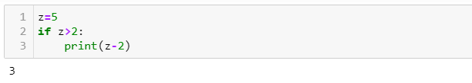
Example of an if condition
Create a variable, z = 5
If z > 2, we want python to print the value of z - 2

Slide 50
if-else-block
Execute another set of instructions if condition is False.
It is also mandatory to put a colon directly behind the else-statement.
Instructions must also be indented as part of the else-block.
if condition:
instructions 1
else:
instructions 2
Notes:
If we intend to let Python execute another set of instructions if the condition is False, and not just skip the if-block, we can add an else-statement to the if-block.
Same as the if-condition, we must add a colon to the else-statement and the instructions following it must be indented as well.

Slide 51
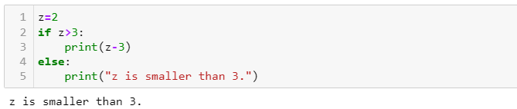
Example of if-else block
Now, we create a variable z = 2
If z > 3, we want python to print the value of z – 3
Else, we want python to print ‘z is smaller than 3’

Slide 52
if-elif-else-block
Execute multiple sets of instructions if-condition has multiple outcomes.
The else-statement is not compulsory here.
Ensure if-statement and elif-statements cover all possible outcomes.
Only omit those possibilities that do not need instructions to follow up.
if condition 1:
instructions 1
elif condition 2:
instructions 2
else:
instructions 3
Notes:
If the construction of the condition allows more than two outcomes, we may need a third, fourth, or even more if-blocks. In this case, we can use the if-elif-else-block.
Note that an if-elif-else-block does not necessarily need an else-statement.
But we should ensure that the conditions being checked by the if-statement and elif-statements must cover all possible outcomes, unless we are certain that only those possibilities are being uncovered which do not need any instructions to follow up.

Slide 53
Activity
Car sales program:
Extend the Car sales program created in the previous chapter with the following functionality:
After entering the brand, model and price of the first car, the user is required to answer they would like enter the same information of a second car. If the user’s reply is yes, ask the user those questions from the previous chapter again. If his reply is no, end the program.

Slide 54
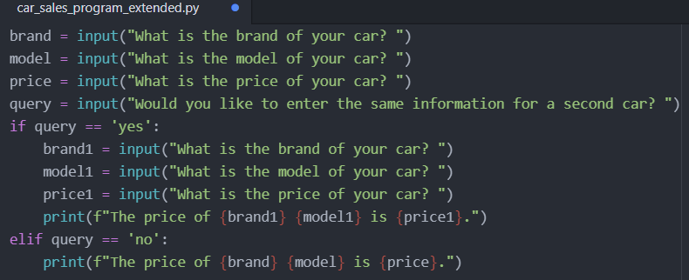
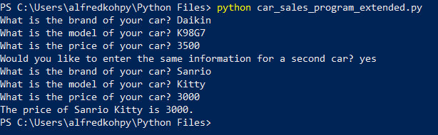
Activity (answers)

Slide 55
Discussion
How do parentheses affect the outcome of a Boolean expression in which logical operators are involved?
When is it sensible just to omit the elif-and/or else-statements in an if-block? When does it make sense to include them?

Slide 56
Discussion (answers)
How do parentheses affect the outcome of a Boolean expression in which logical operators are involved?
Parentheses have priority
When is it sensible just to omit the elif-and/or else-statements in an if-block? When does it make sense to include them?
Omit the elif if we do not expect output from the else condition

Slide 57
15 min Break

Slide 58
Loops

Slide 59
while-Loops
Loops is used to repeat instructions that will be applied for many times.
The condition controls whether the loop will run a new iteration or not.
If it is True, Python will execute the instructions written with indentation.
Number of loops can be infinite.
The loop will be repeated as long as the condition is True.
Ensure there is an exit condition for the loop to terminate.
while condition:
instructions
Notes:
In the student score example, we construct a program in which the name and the mark of one student can be entered.
In the early stage of our example, we had scores of two students. If we let these two students to enter their names and then assigned a grade to each of them, we would have to repeat those codes twice.
We usually have even more than two students in one class. In order not to expand our codes endlessly and make it clumsy and unreadable, we can construct a loop in our program to repeat the instructions that will be applied for many times. The first type of loops that we will introduce here is the while-loops.
The condition is a Boolean expression which controls whether the loop will continue to run for a new iteration or not. If the condition is True, Python will go on to execute the instructions that are written with indentation and after the colon behind the condition.
The number of loops can be infinite and will be repeated as long as the condition is True. As a result, it is extremely important to ensure that the while-loops will be terminated at some stage by fulfilling an exit condition.

Slide 60
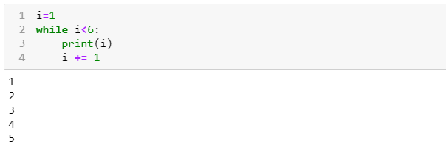
Example of while loop
Create a variable i = 1
while i < 6, print i
increase i by 1 for each iteration to prevent infinite loop
i.e., i += 1

Slide 61
Generate Integer list
A for-loop needs a list to iterate.
The number of loops is equivalent to the length of the list.
To generate a simple list of consecutive integers:
Basically, for-loop supports the iteration through any Python list.
variable = range(start, end)
Notes:
Another type of loops is the for-loops, which are constructed differently.
While we need a True-condition for the while-loops to continue to iterate, we need a list for the running of the for-loops.
Here, we will first learn to generate a simple list of consecutive integers by the range() function.

Slide 62
for-Loops
Integrate the range() function in the for-statement:
The for-command ends with a colon.
Instructions executed in each iteration are written with indentation.
Counter variable counts the iteration of the loop.
Loop ends when counter reaches end – 1.
for counter in range(start, end):
instructions
Notes:
The start value can be any integer as long as it is smaller than the end value.
Note that the end value is not included in the list. In other words, the list will end at end – 1. For the for-loops, we can integrate the range() function in the for-statement directly.
The for-command must end with a colon, followed by the instructions that should be carried out in each iteration. The instructions must be written with indentation.
The counter variable will do the counting for the iterations, starting from the start value in the first iteration and running through the entire integer list.
Once the counter reaches end – 1, Python will execute the instructions for a last time and then exit the loop.

Slide 63
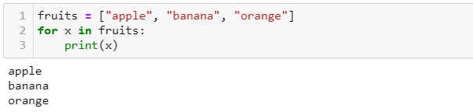
Example of for-loop
Create a list of fruits = ["apple", "banana", "orange"]
For each element in fruits, print the element

Slide 64
Error Handling
Python stops executing program once error occurs.
To avoid Python from stopping the execution by force:
try:
instructions
except exception:
instructions
else:
instructions
finally:
instructions
Notes:
Another common use of loops is to control the user’s input following an input() statement.
For instance, it could happen that the user types in a letter instead of a number for the exam score by accident. In this case, we would like the user to redo the input until it is a number. As a result, we can put the input() statement within a while-loop and break from it only then, when the input of the user is valid.
Before we come to the step to build in while-loops for user inputs, we have to learn how Python handles errors.
We know that if we apply the int() function to convert a string variable that contains a non-numeric value to an integer, the program will be interrupted due to error. And the user will have to restart the program in PowerShell.
This can be very annoying if the user only makes a small mistake in one of the input fields, but he needs to re-type all the inputs from the beginning because of the interruption of the program.
The try-except-block is an important instrument in Python to handle errors.
Basically, we can put any syntax in the try-block if we think error can occur in those syntaxes.
The except-block is to tell Python to continue with the program except for the occurrence of an error, or the occurrence of a specific error that we declare under exception.
If error indeed occurs, Python will carry out the instructions written after the colon behind the except-statement, instead of stopping the program entirely.
The else-block and finally-block are optional and can be used if we want certain instructions to be carried out if no error occurs or for finalising a try-block.

Slide 65
Exceptions
List of some common built-in exceptions in Python:
Exception | Description
NameError | Raised when a local or global name is not found. This applies only to unqualified names. The associated value is an error message that includes the name that could not be found.
TypeError | Raised when an operation or function is applied to an object of inappropriate type. The associated value is a string giving details about the type mismatch.
ValueError | Raised when an operation or function receives an argument that has the right type but an inappropriate value, and the situation is not described by a more precise exception.
Notes:
In Python, there are many built-in exceptions. We recommend you visit the official Python website to get the entire list. The table here contains some common exceptions.
If the user is asked to enter a numeric value such as an exam score, but enter a string instead, we can use ValueError as our exception.

Slide 66
Error Handling in Input
Construct a while-loop around a try-block to handle errors.
The loop condition indicates the validity of an input.
If this Boolean variable is True (input is valid), the program will break from the loop.
Notes:
After defining the try-block to instruct Python on how to handle errors, we can construct a while-loop around it.
As condition for the loop to continue iterating is when a Boolean variable that indicates a valid input does not change from False to True.
Hence, if this Boolean variable is True, the program will break from the loop.

Slide 67
Activity
Car sales program:
Extend the Car sales program by using a loop to let the user enter the information of as many cars as he wants. The program will only end if the user answers the question whether he wants to quit the program or not with “yes”. Note that the program must also control the validity of the input (i.e., the selling price of a car must be numeric, etc.).

Slide 68
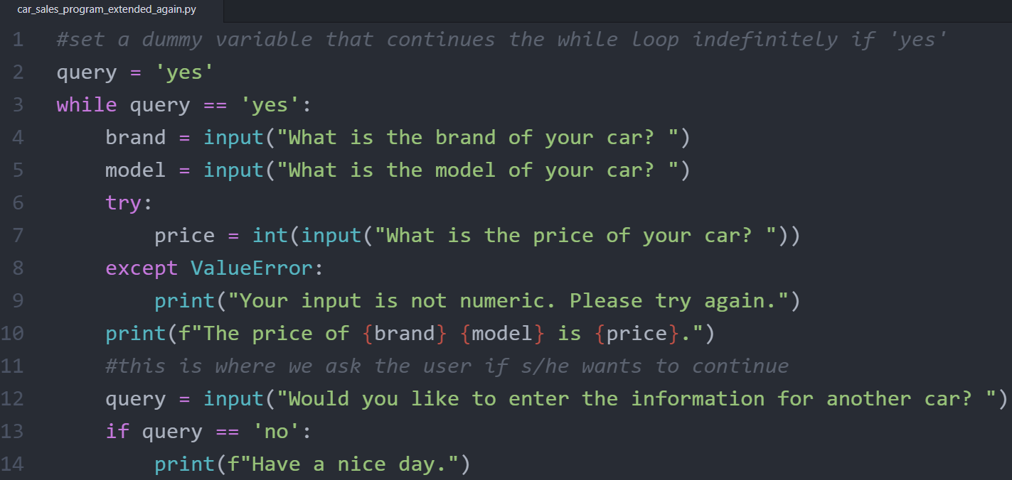
Activity (discuss how the codes work)
Car sales program:
Extend the Car sales program by using a loop to let the user enter the information of as many cars as he wants. The program will only end if the user answers the question whether he wants to quit the program or not with “yes”. Note that the program must also control the validity of the input (i.e., the selling price of a car must be numeric, etc.).

Slide 69
Discussion
What is the main difference between a while-loop and a for-loop?
When do we need to use the break command to break out from a loop although all exit conditions are working properly?

Slide 70
Discussion (answers)
What is the main difference between a while-loop and a for-loop?
while loop runs infinitely many times
When do we need to use the break command to break out from a loop although all exit conditions are working properly?
when we want to skip steps and save computing time

Slide 71
Online Learning Platform (Optional)
If-elif-else condition:
https://www.w3schools.com/python/python_conditions.asp
While loop:
https://www.w3schools.com/python/python_while_loops.asp
For loop:
https://www.w3schools.com/python/python_for_loops.asp
Functions:
https://www.w3schools.com/python/python_functions.asp

